Slide 1
BOS Fellowship Committee Update
Scott Steinmann, MD
Professor and Assistant Dean, University of Tennessee
Emeritus Professor of Orthopedic Surgery Mayo Clinic

Slide 2
Disclosure
I (and/or my co-authors) have something to disclose. Detailed disclosure information is available via: The course syllabus, or AAOS Disclosure Program on the AAOS website at http://www.aaos.org/disclosure

Slide 3
Fellowship Oversight Committee
Scott Steinmann, MD (Chair)
Jeff Dugas(Vice-Chair)
Sports Medicine
John Richmond, MD
Arthroscopy
Michael Taunton, MD
Adult Reconstruction
Andrew Schoenfeld, MD
Spine
John Campbell, MD
Foot and Ankle
Dawn Laporte, MD
Hand
Madhav Karunakar, MD
Trauma
Raffi Avedian, MD
Musculoskeletal Tumor
John C. Richmond, MD
Arthroscopy
Thomas Wright, MD
Shoulder and Elbow
Marcella Woiczik, MD
Pediatrics
Kevin Plancher, MD
AAOS BOS Chair
C. Craig Satterlee, MD
AAOS BOS Past - Chair
Staff Liaisons
Evette Thompson, MA, CDF, CCC
Donna Malert, CAE

Slide 4
AAOS BOS Fellowship Committee Charges
Oversight of fellowship issues as they arise
Input into accreditation / recognition issues
Assistance with educational objectives
Post-fellowship surveys
Ensure fair process for applicants

Slide 5
Single Match Day Update
Background:
2019 was the first Single Fellowship Match
All specialties except hand surgery
Uniform Application and requested materials
Application
CV
Three Letters of Reference
All specialties, except Hand, currently use SF match for fellowship match
Hand (NMRP)
Applicants can apply to, and rank, programs in different specialties and the best match applies

Slide 6
2022 Match Update
Adult Reconstruction and Hand surgery interest continues to increase
Sports medicine still has most positions
Other specialties remaining mostly steady from prior years
90-95% of graduating residents matriculating to a fellowship year
Steady number of applicants from osteopathic programs and slight decline of FMG’s

Slide 7
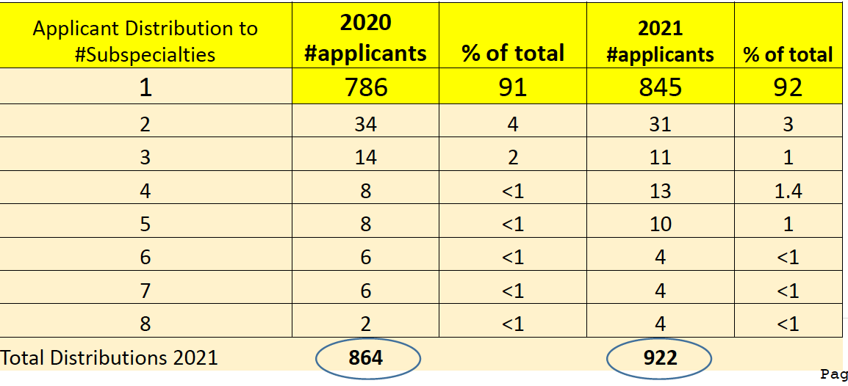
Applicant Data 2022
Applicant pool is larger 969 (47 more than 2021)
• 92% apply to one subspecialty – stable
• Applicants applied to average of about 30 programs
.

Slide 8
Programs and Positions offered
Overall:
16 new fellowship programs in SF Match
20 new fellowship positions available

Slide 9
Applicant Trends

Slide 10
Programs and Positions 2022

Slide 12
Positions Filled

Slide 13
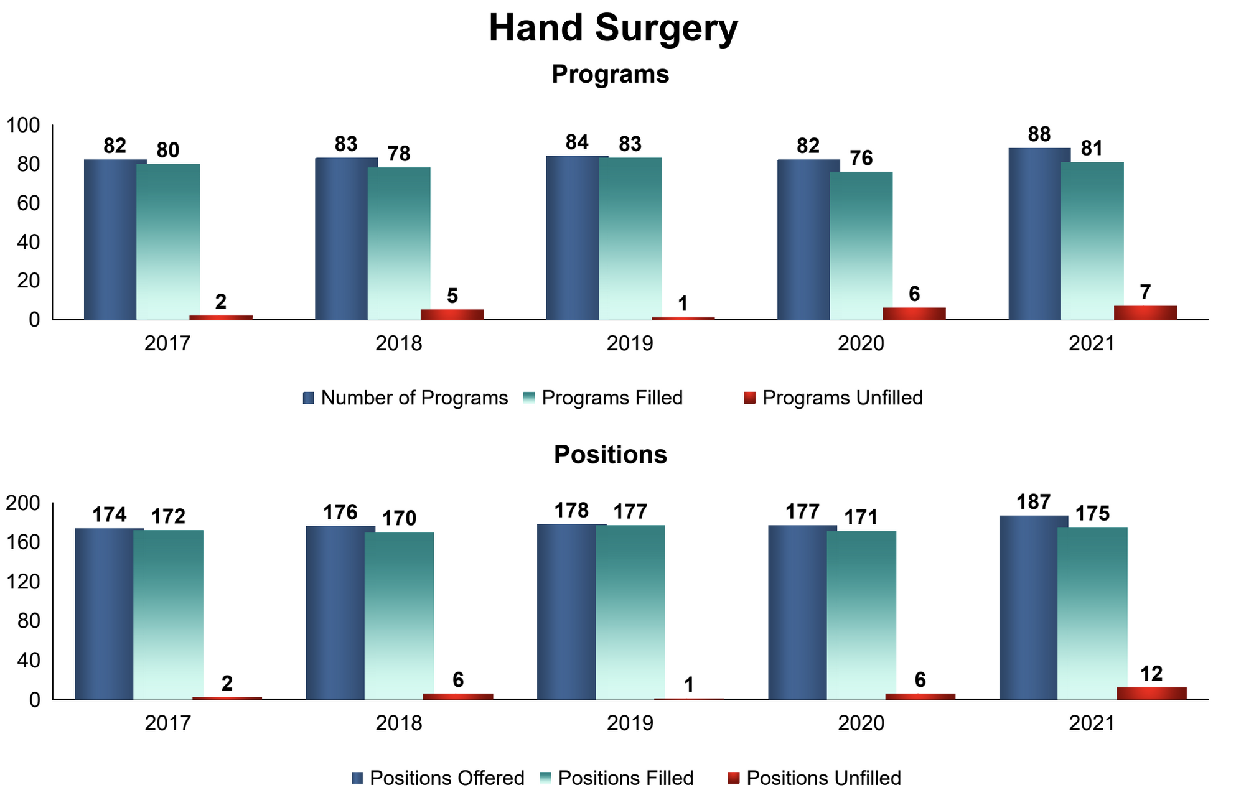
Hand Surgery Match NMRP

Slide 14
Matched Applicants and Number of Applications

Slide 15
Most applicants apply to one specialty

Slide 16
ACGME programs

Slide 20
Accreditation
Hand and Sports Medicine
Specialty certificate through ABOS
ACGME
Pediatrics, Trauma, Shoulder / Elbow
Society driven accreditation programs
Fellowship program criteria
Case log monitoring
Adult Reconstruction, Foot/Ankle, Spine, Musculoskeletal Tumor
In varying stages of interest and exploration

Slide 21
What’s on the horizon for 2021- 22 and beyond?
Last year, interviews were all virtual in line with AAMC policies for residency interviews
The Committee met in June 2021 and determined each specialty will have a uniform decision by specialty (in person/hybrid or virtual only
This year again over 90% virtual interviews
Hopefully next year we can return to in person interviews, but virtual serves a role and will continue

Slide 22
BOS
Support is integral since specialty societies are integrated deeply into fellowship education
Zoom meetings over the past year, but good to have face to face meetings
AAOS Sept 2021
AAOS March 2022
BOS great help to distribute information from fellowship committee to fellowship programs and applicants

Slide 23
Thank You
steinmann.scott@mayo.edu

